Slide 1
The Paired-Samples t-Test
Chapter 10

Slide 2
Research Design Issues
So far, everything we’ve worked with has been one sample
One person = z score
One sample with population standard deviation = z test
One sample no population standard deviation = single t-test

Slide 3
Research Design Issues
So what if we want to study either two groups or the same group twice
Between subjects = when people are only in one group or another (can’t be both)
Repeated measures = when people take part in all the parts of the study

Slide 4
Research Design Issues
Between subjects design = independent t test (chapter 11)
Repeated measures design = dependent t test (chapter 10)

Slide 5
Research Design Issues
So what do you do when people take things multiple times?
Order effects = the order of the levels changes the dependent scores
Weight estimation study
Often also called fatigue effects
What to do?!
Notes:
Weight estimation study? Order of light vs. heavy weight changes participant estimations

Slide 6
Research Design Issues
Counterbalancing
Randomly assigning the order of the levels, so that some people get part 1 first, and some people get part 2 first
Ensures that the order effects cancel each other out
So, now we might meet this random selection assumption

Slide 7
Assumptions
Assumption | Solution
Normal distribution | N ≥ 30
DV is scale | Nothing… do non-parametrics
Random selection (sampling) | Random assignment (We can do this now though counterbalancing!)

Slide 8
Paired-Samples t Test
Two sample means and a within-groups design
We have two scores for each person… how can we test that?
The major difference in the paired-samples t test is that we must create difference scores for every participant

Slide 9
Paired-Samples t Test
Distributions
z = distribution of scores
z = distribution of means (for samples)
t = distribution of means (for samples with estimated standard deviation)
t = distribution of differences between means (for paired samples with estimated standard deviation)

Slide 10
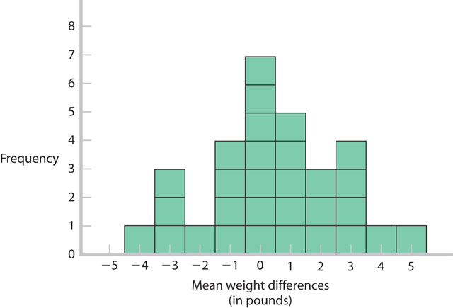
Distribution of Differences Between Means

Slide 11
Distribution of Differences Between Means
So what does that do for us?
Creates a comparison distribution (still talking about t here … remember the comparison distribution is the “population where the null is true”)
Where the difference is centered around zero, therefore um = 0.

Slide 12
Distribution of Differences Between Means
When you have one set of scores by creating a difference score …
You basically are doing a single sample t where μ_{M} = 0
Whew! Same steps

Slide 13
Steps for Calculating Paired Sample t Tests
Step 1: Identify the populations (levels), distribution, and assumptions
Step 2: State the null and research hypotheses
Step 3: Determine the characteristics of the comparison distribution
Step 4: Determine critical values, or cutoffs
Step 5: Calculate the test statistic
Step 6: Make a decision

Slide 14
Step 1
List out the assumptions:
DV is scale?
Random selection or assignment?
Normal?

Slide 15
Step 2
List the sample, population, and hypotheses
Sample: difference scores for the two measurements
Population: those difference scores will be zero (μ_{M} = 0)

Slide 16
Step 3
List the descriptive statistics
M_{difference}:
SD_{difference}:
SE_{difference}:
N:
μ_{M} = 0

Slide 17
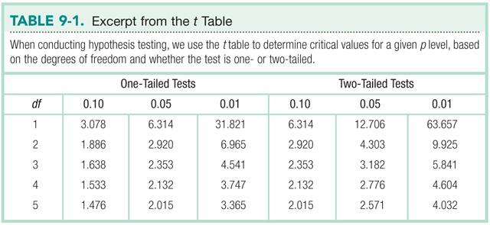
Step 4
Figure out the cut off score, t_{critical}
df = N - 1
Notes:
**May also be .01 – remember to read the problem.

Slide 18
Step 5
Find t_{actual}:
t_{actual} = M_{difference} / SE_{difference}
Stop! Make sure your mean difference score, df, and hypothesis all match
Notes:
S_{M} = standard error

Slide 19
Step 6
Compare step 4 and 5 – is your score more extreme?
Reject the null
Compare step 4 and 5 – is your score closer to the middle?
Fail to reject the null

Slide 20
Confidence Interval
Lower = M_{difference} – t_{critical}*SE
Upper = M_{difference} + t_{critical}*SE
**know the formula, but you can also do this in JASP

Slide 21
Effect Size
Cohen’s d:
d = mean difference / s
s = SD of difference scores
Notes:
s = SD of difference scores

Slide 22
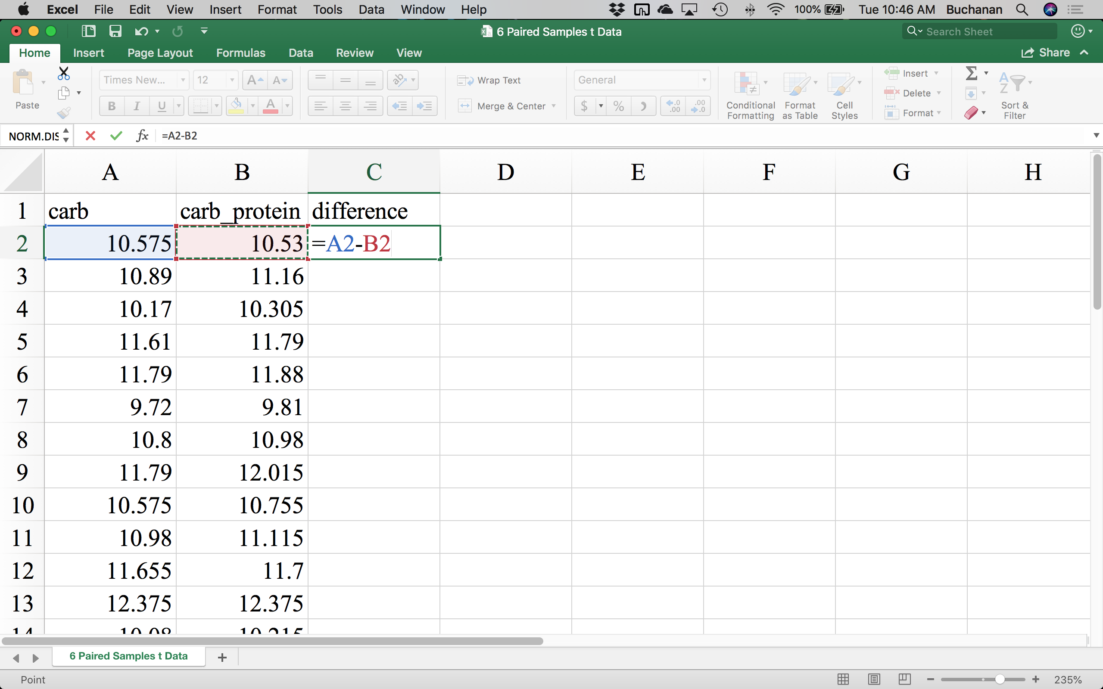
How to JASP
First we have to calculate our difference scores in Excel:

Slide 23
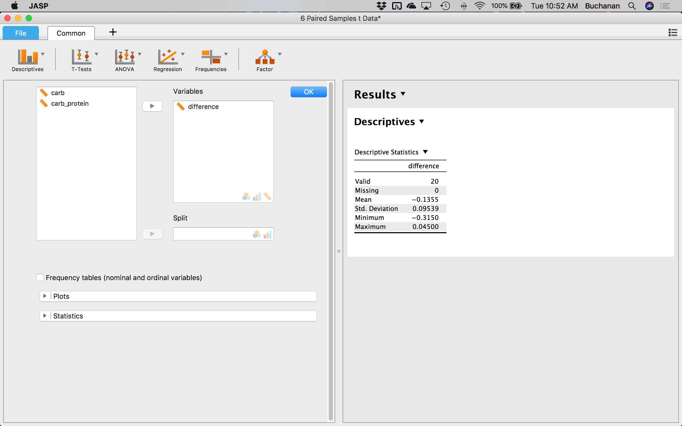
How to JASP
Save that and pull the data up in JASP
From here you find outliers like before, except using the difference scores as the variable you are checking

Slide 24
How to JASP
Make a distribution plot
Does it look like a bell curve?
Make a box plot and label outliers
Descriptives → Descriptive Statistics → Plots → select “Distribution plots” and “Boxplots”
Under Boxplots select “Label Outliers” and “Jitter Element”
Anything outside the top and bottom lines would be labeled an outlier

Slide 25
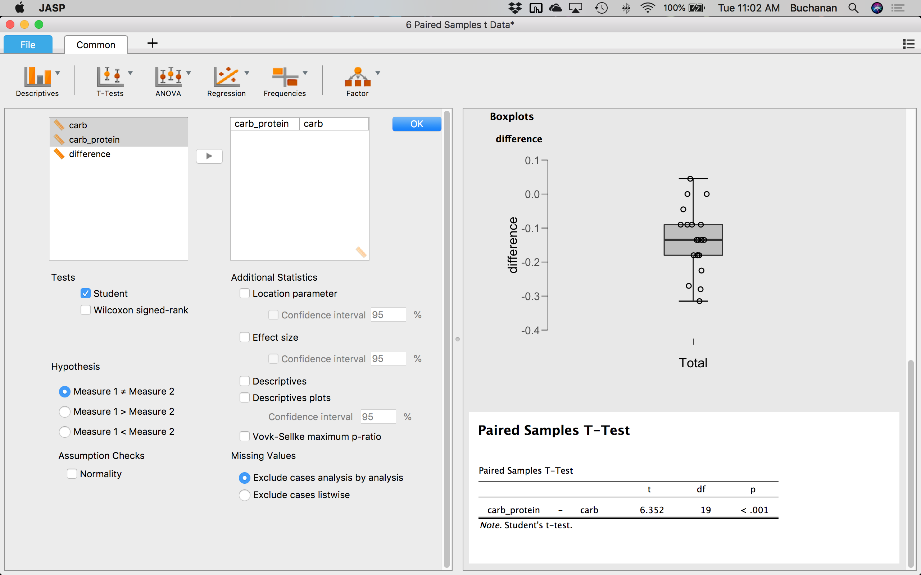
How to JASP
Now we can run the t test and check for normality
Go to T-Tests → Paired Samples T-Test
Select the two variables you are comparing and move them to the right

Slide 26
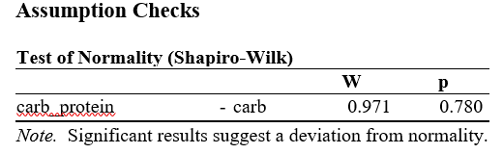
How to JASP
To find out if the data meets normality, select “Normality” under “Assumption checks”

Slide 27
How to JASP
Since we are doing a two-tailed test, you would select Measure 1 ≠ Measure 2 for the hypothesis
Selecting “Effect size” will give you Cohen’s d
Selecting “Location parameter” and “Confidence interval 95%” will give you the 95% CI for the mean difference
Can also select “Descriptives” to get those

Slide 28
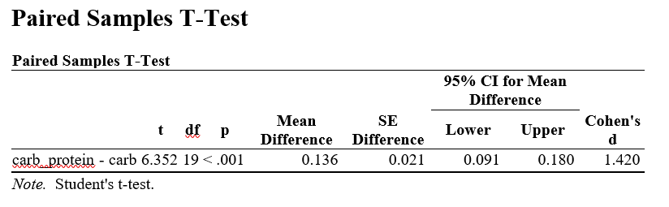
How to JASP
Now we just interpret our results
Reporting in APA:
A statistically significant mean increase of 0.14 km, 95% CI [0.09, 0.18], t(19) = 6.35, p < .001, d = 1.42 was found in our study.

Slide 29
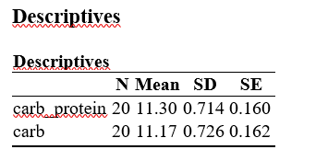
How to JASP
The descriptives output tells you a little extra
From this we can tell which condition helped participants run further:
Participants ran further when imbibing the carbohydrate-protein drink (M = 11.30, SD = 0.72 km) as opposed to the carbohydrate only drink (M = 11.17, SD = 0.73 km).

Slide 30
Putting in Together
Participants ran further when imbibing the carbohydrate-protein drink (M = 11.30, SD = 0.72 km) as opposed to the carbohydrate only drink (M = 11.17, SD = 0.73 km), a statistically significant mean increase of 0.14 km, 95% CI [0.09, 0.18], t(19) = 6.35, p < .001, d = 1.42.

